Slide 1
MAG analysis reveals Tannerella
serpentiformis relationship with dental implant inflammation
Alex Callegaro, Alberto Catalano, Alessandro Fiume
Computational Microbial Genomics - 2024/2025

Slide 2
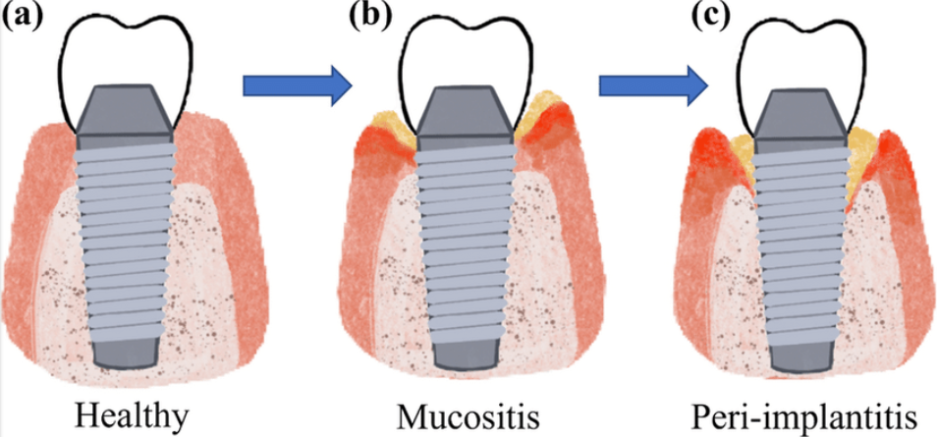
Introduction
MAG analysis of oral microbiota
Dental implant conditions:
Healthy
Mucositis
Peri-implantitis
Xu, A. et. al. (2022). Peri-Implantitis in Relation to Titanium Corrosion: Current Status and Future Perspectives.
‌
Objectives
Taxonomic assignment
Phylogenetic profiles
Genome annotations
Pangenome analysis

Slide 3
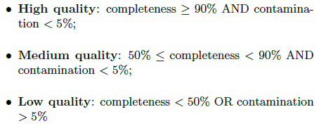
Methods
Quality check 🡪 CheckM (taxonomic workflow)
Taxonomic assignment 🡪 PhyloPhlAn (5% Mash distance)
Genome annotations 🡪 Prokka
Pangenome analysis 🡪 Roary (90% core genes)
Phylogenetic analysis 🡪 FastTreeMP + iTOL
Tannarella forsythia as outgroup

Slide 4
Discussion and Results

Slide 5
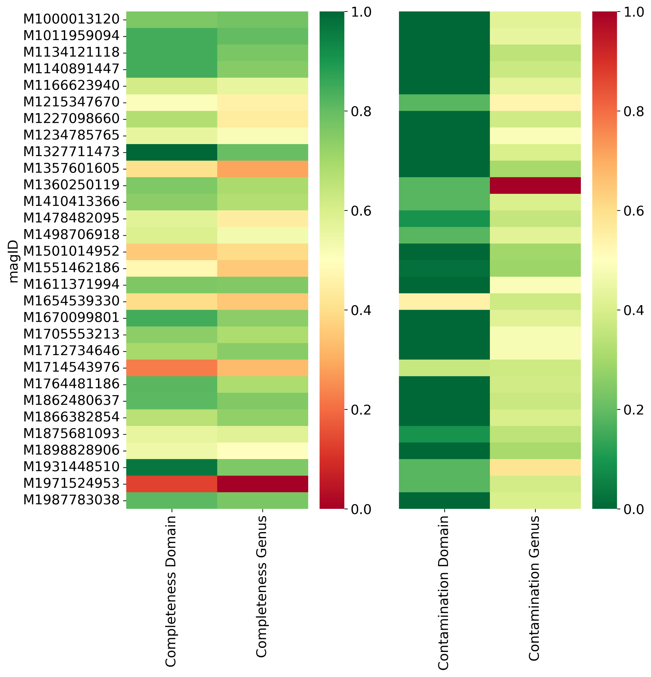
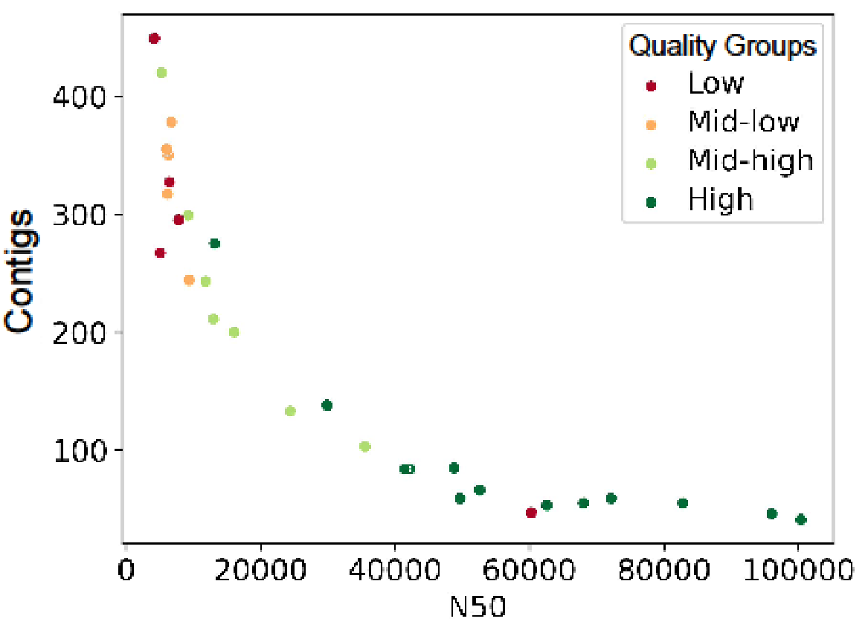
Quality assessment

Slide 6
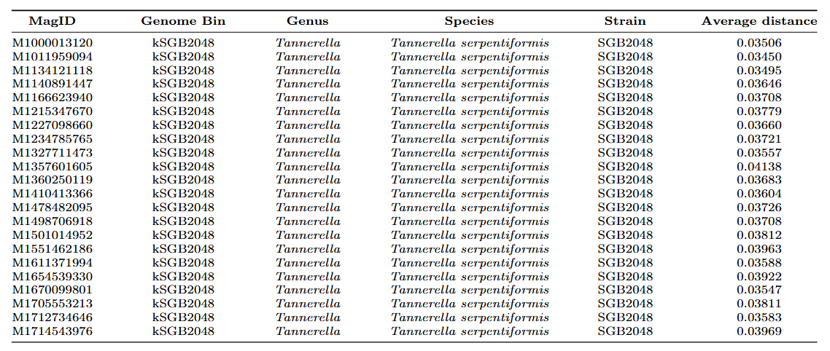
Taxonomic assignment

Slide 7
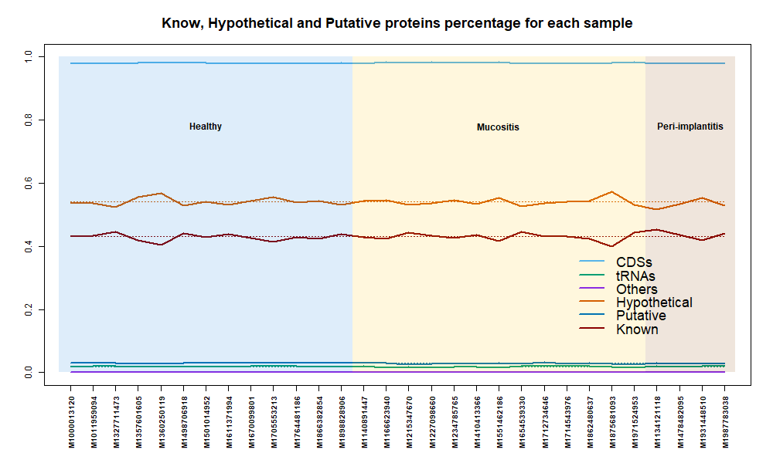
Genome annotations

Slide 8
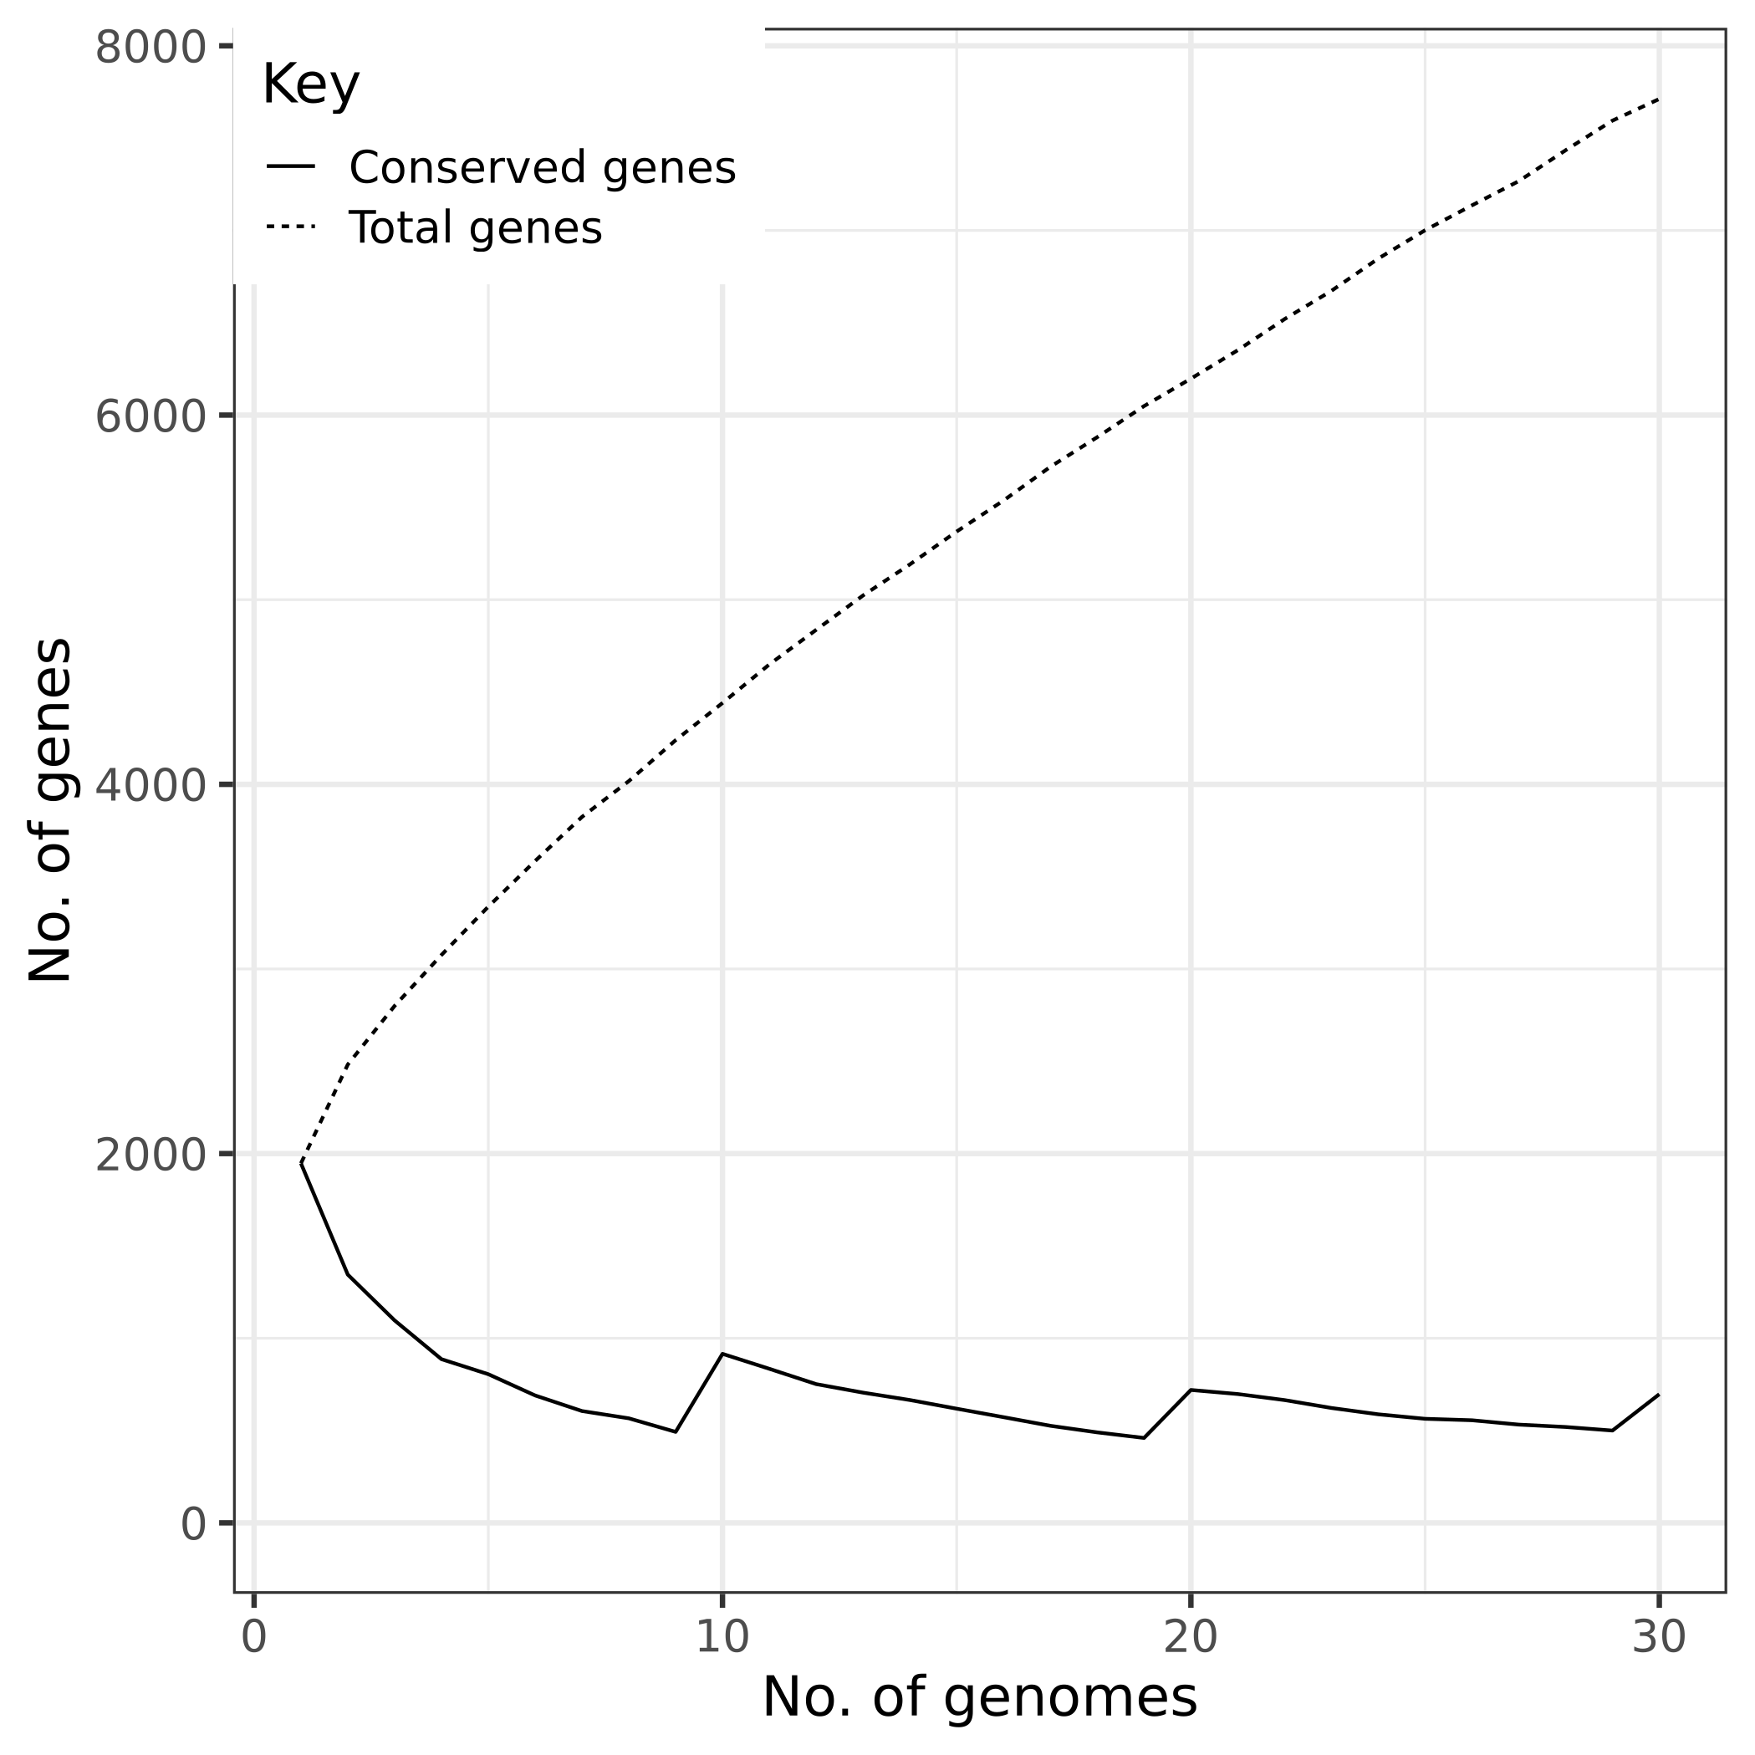
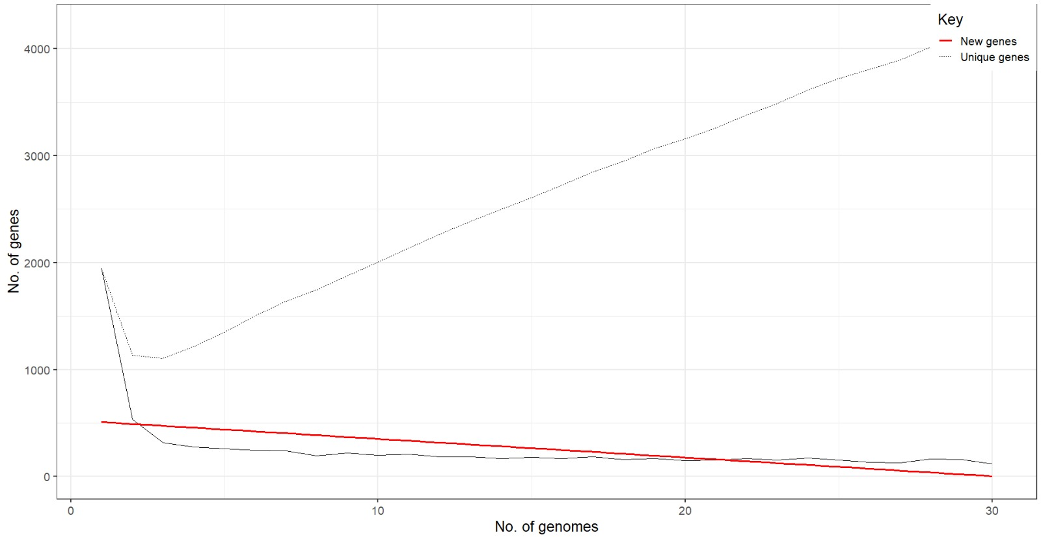
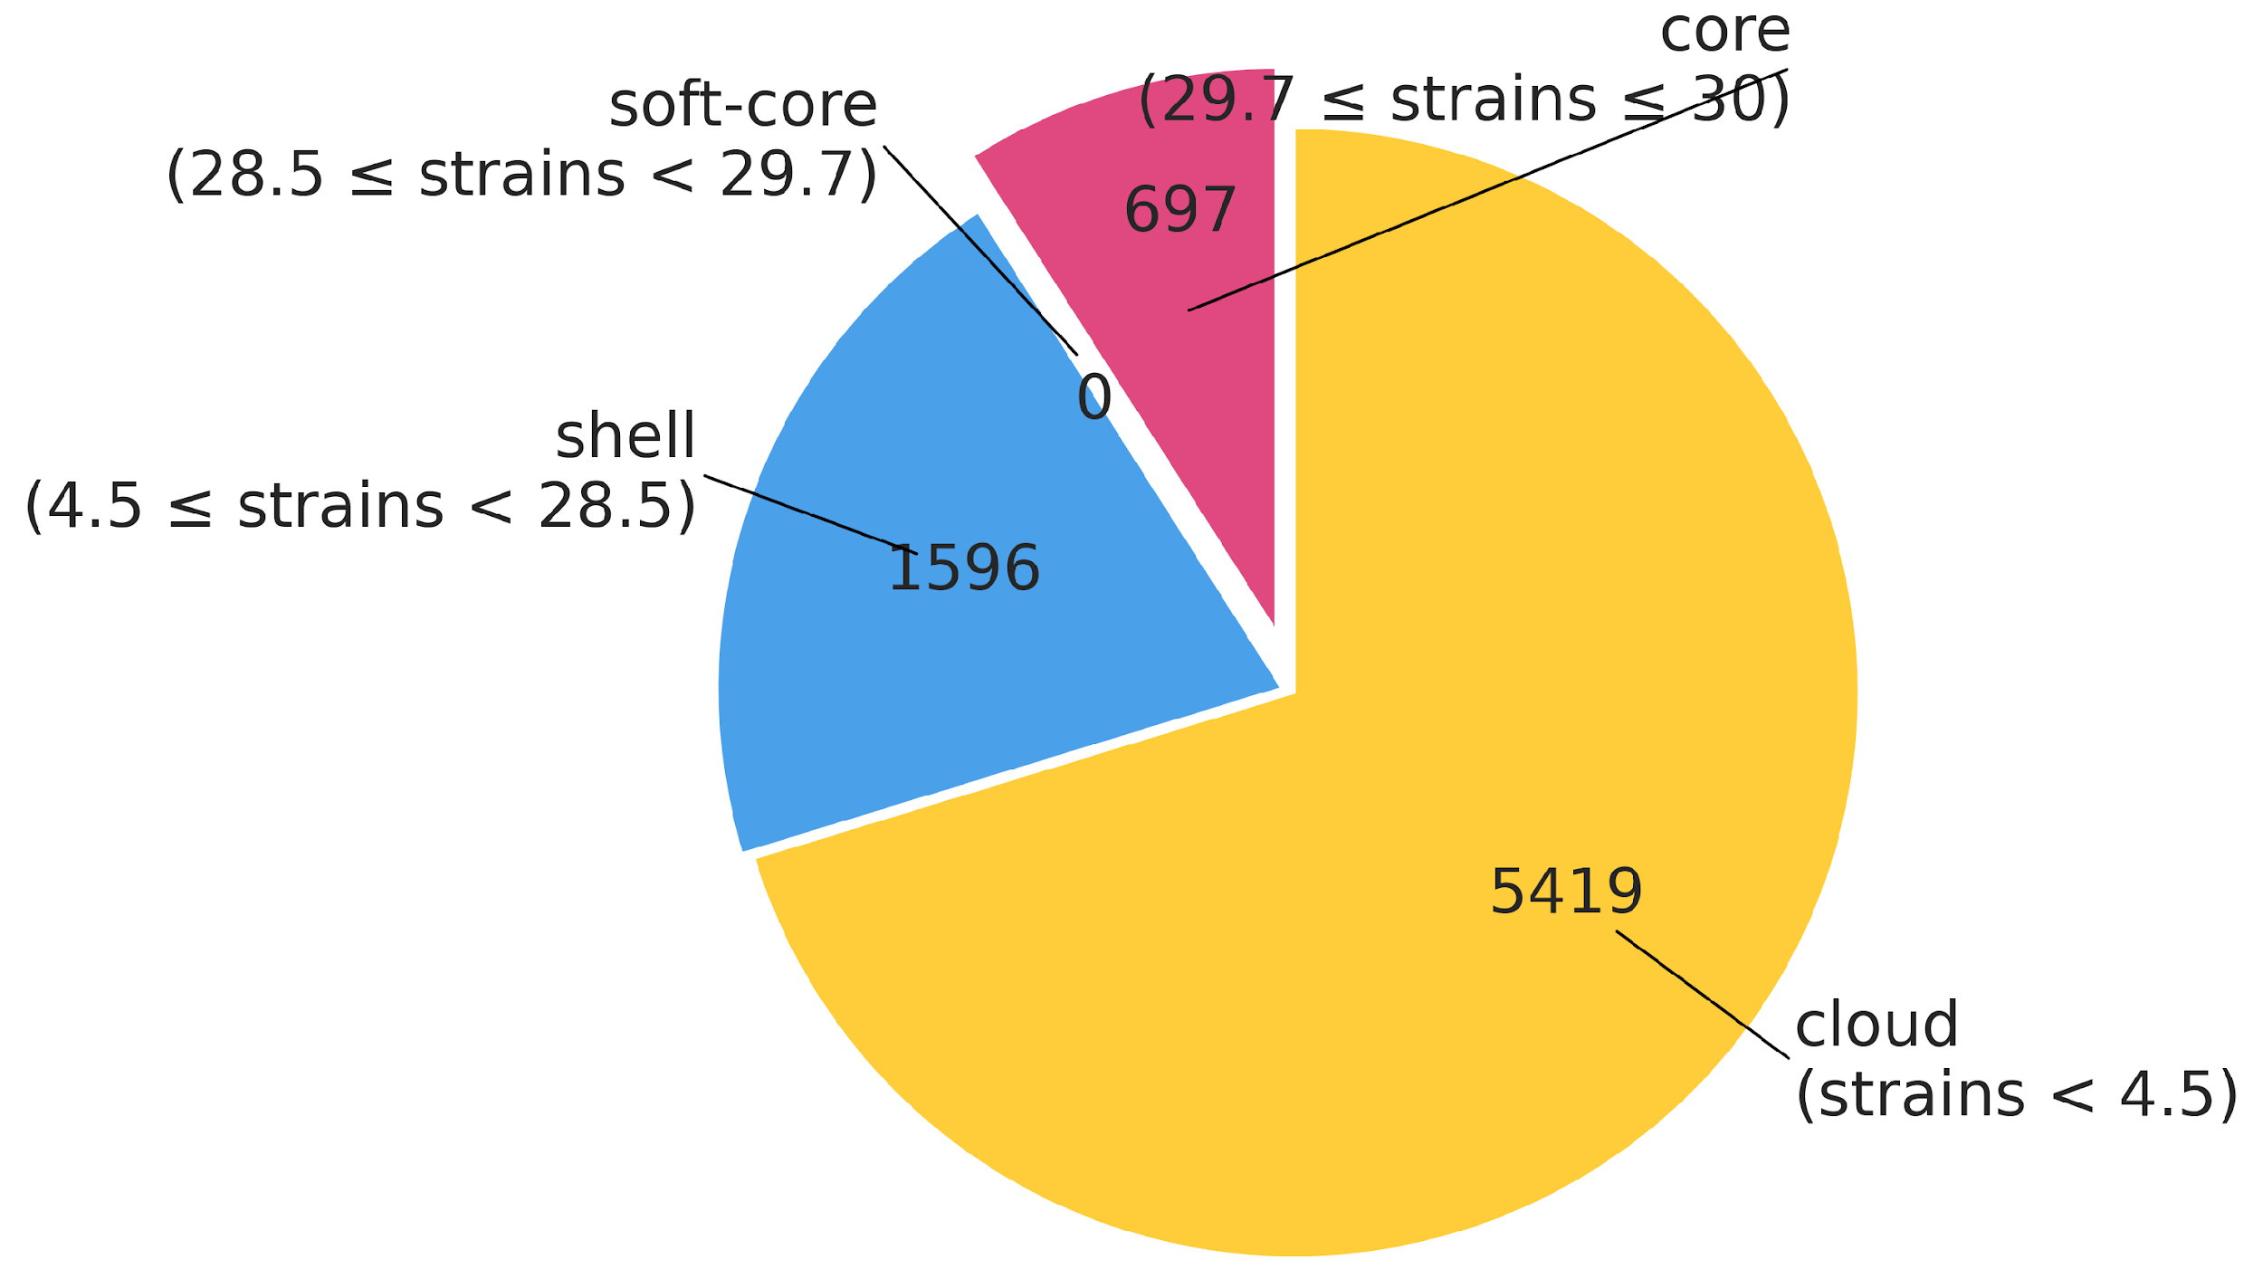
Pangenome analysis

Slide 9
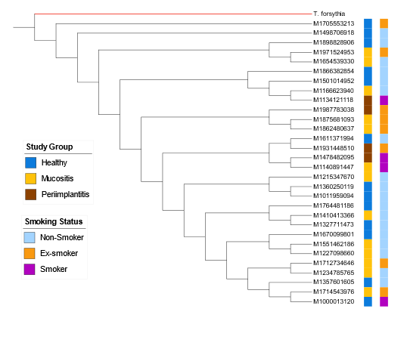
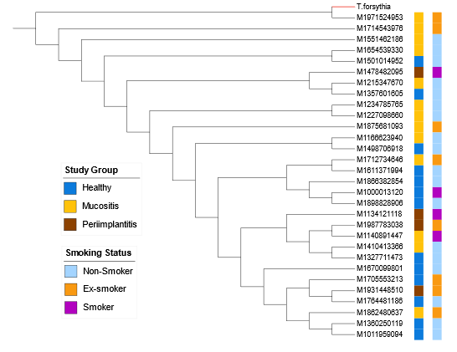
Phylogenetic analysis
Core tree
Accessory tree

Slide 10
Conclusion Thanks for attention !

